Slide 1

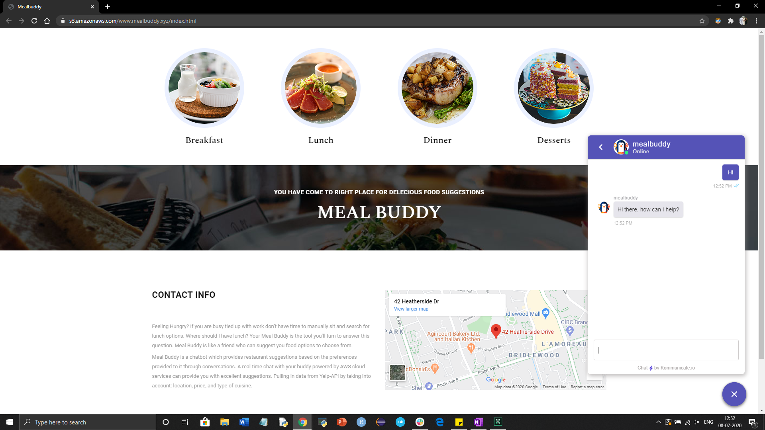

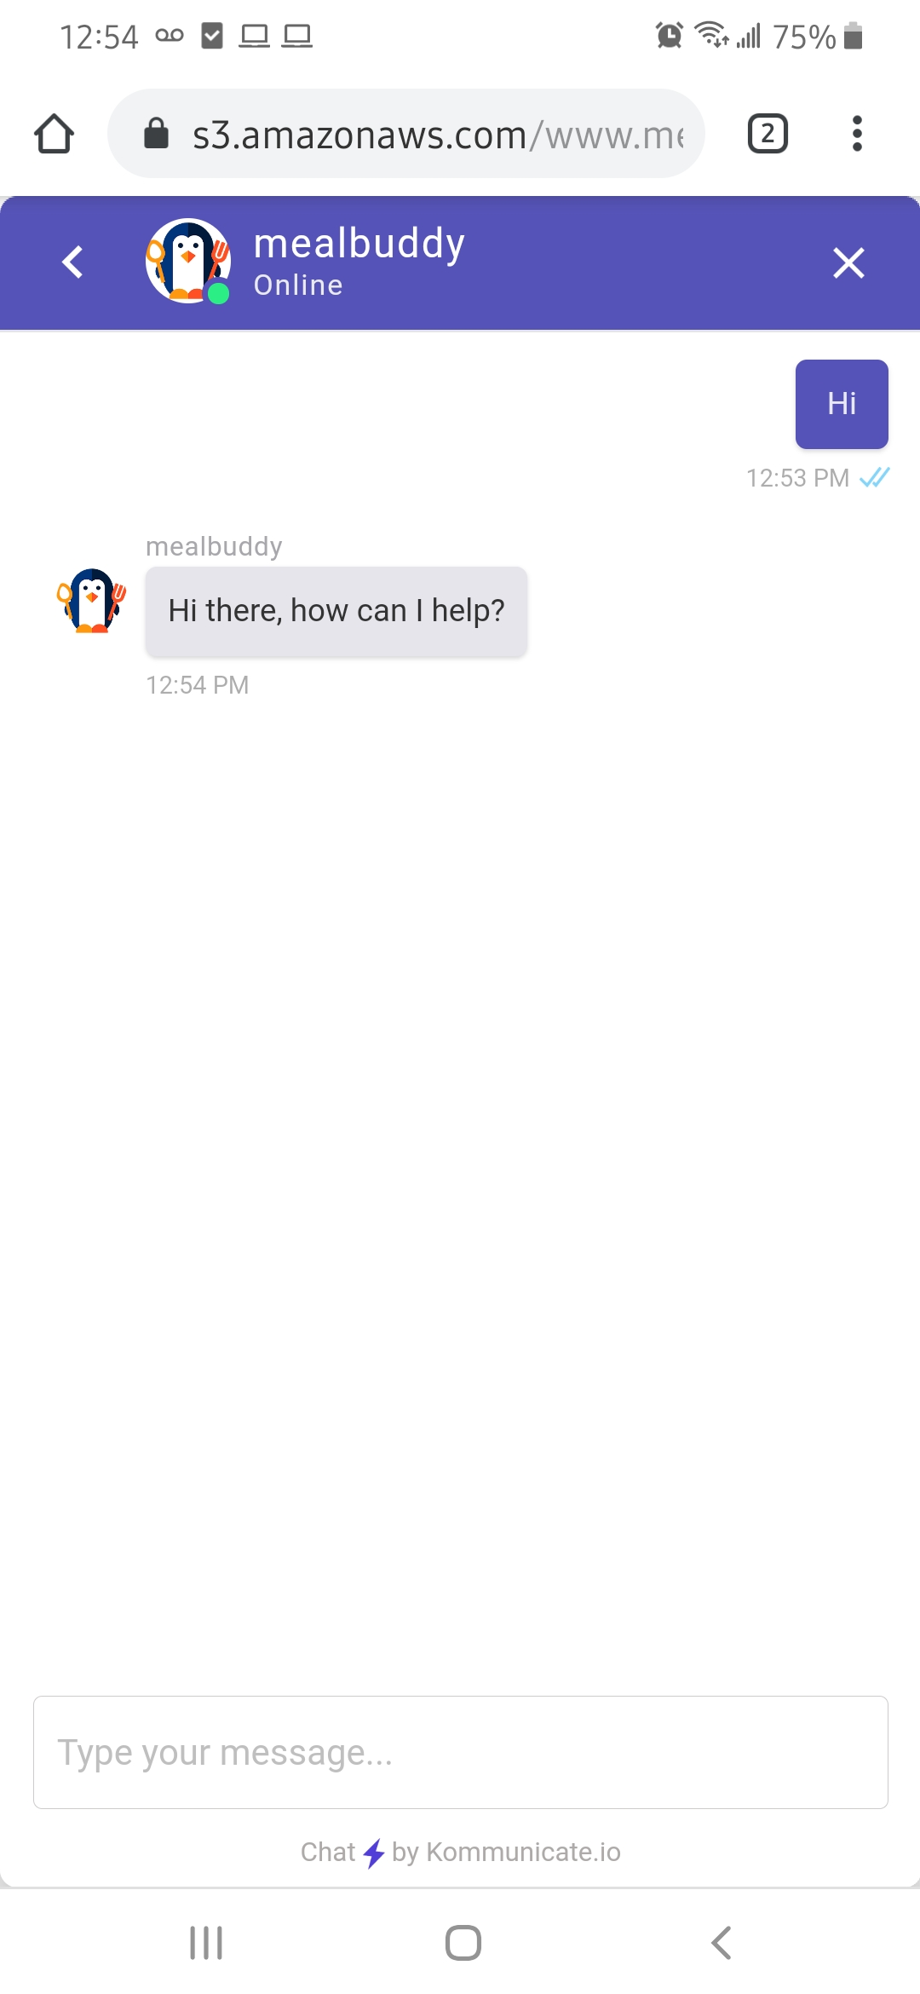

MealBuddy
ELVIN IYPE MATHEW C0769974
ELDA VARGHESE C0769741
TOM JOSEPH C0760915
JEENA HELEN FRANCIS C0764493
CHINJU BABY C0769912
Capstone Project
A friend who can suggest you food options through chat
By Group G
Faculty Supervisor
WILLIAM POURMAJIDI

Slide 2


Problem & Solution Proposal

Slide 3
Introduction
Serverless, microservice-driven web application
Created completely using AWS services and third party Kommunicate API.
Mealbuddy Chatbot that can simulate a conversation with a user in natural language.
Helping the user to make wiser decisions through the recommendations made by machine learning.
Mealbuddy chatbot application will send restaurant suggestions to users through SMS.

Slide 4
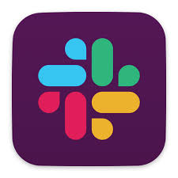

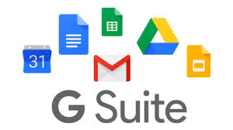
Software Development Tools
SLACK
Github
GSuite

Slide 5
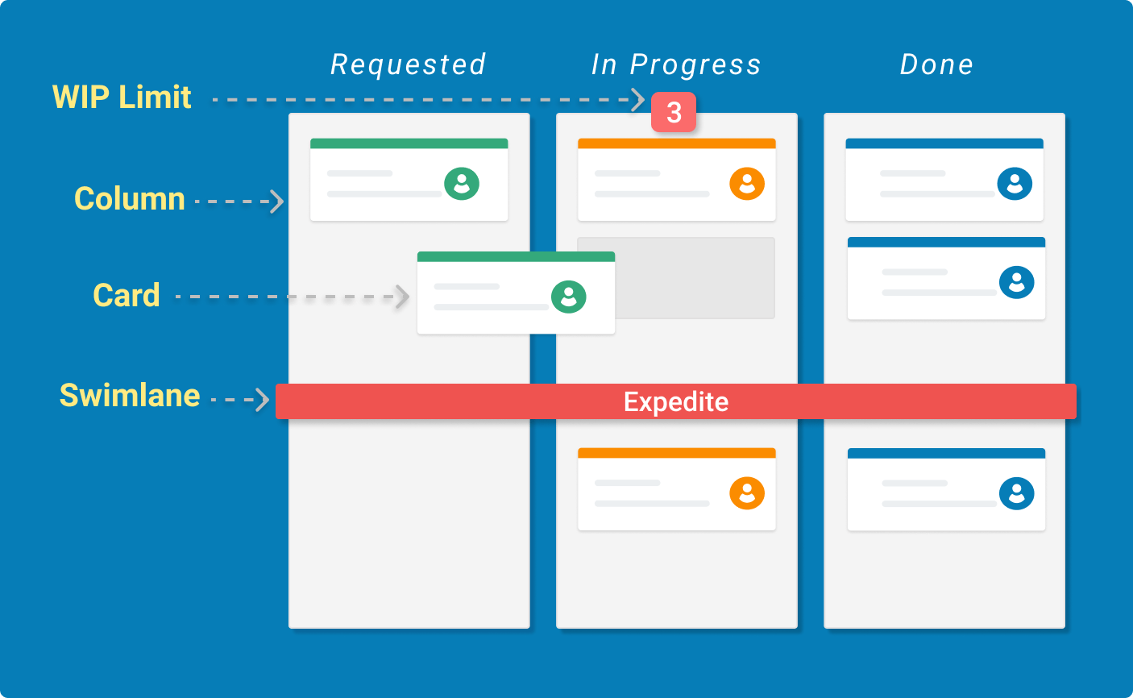
Project Management Tool
Jira Software is software which allows team to plan,track, and release great software.
Kanban is a popular framework used to implement agile software development.
It requires real-time communication of capacity and full transparency of work. Work items are represented visually on a kanban board, allowing team members to see the state of every piece of work at any time.

Slide 6
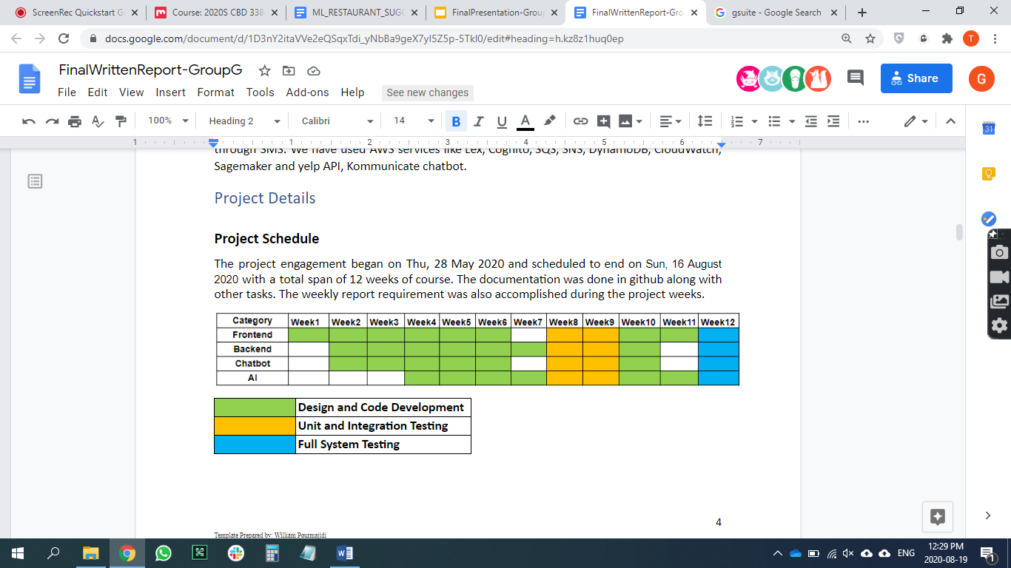
Timeline

Slide 7
Limitations / Constraints / Restrictions
The restaurant is limited to the Toronto region.
The recommendation is currently based on factors like cuisine, ratings, review countings.
Response and input limitations to chat conversations and queries for Lex , Kommuincate, Slack

Slide 8
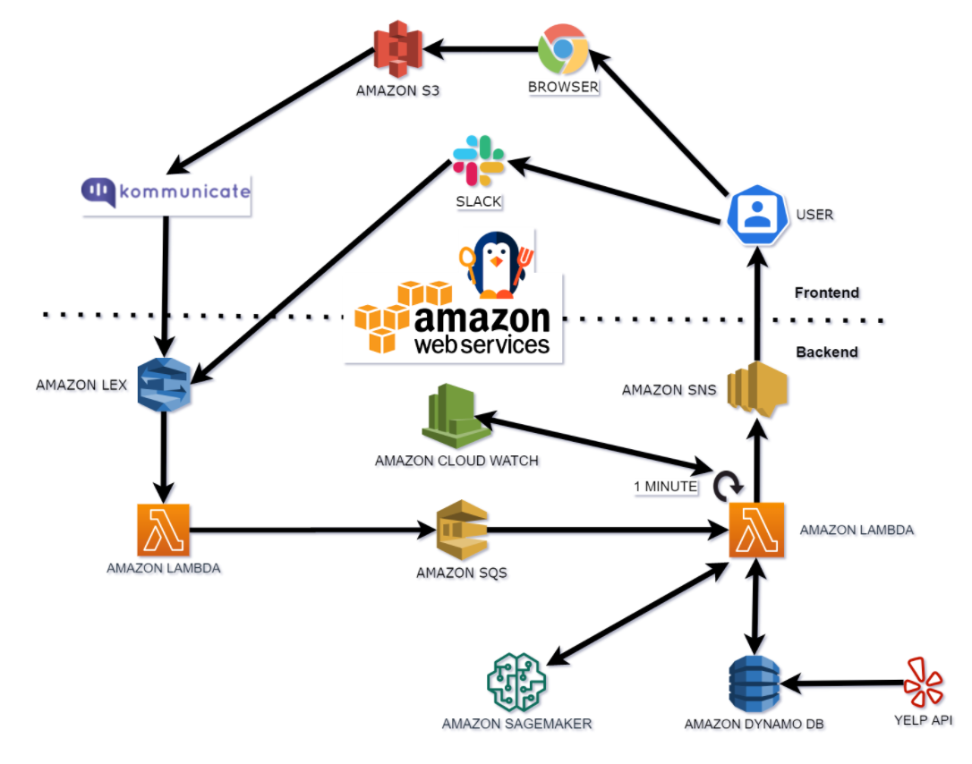
Architecture Diagram

Slide 9
Deploy Frontend UI
We hosted our web application in S3 bucket.
Step 1: Create a bucket named www.mealbuddy.xyz
Step 2: Enable static website hosting
Step 3: Edit block public access settings
Step 4: Add a bucket policy that makes your bucket content publicly available
Step 5: Configure an index document
Step 6: Test your website endpoint
Notes:
S3 - Simple Storage Service, is one of Amazon's longest running AWS offerings. It's purpose is to provide easy-to-use cloud storage that is scalable, highly available, and reliable.

Slide 10
Slack Integration
Create a Slack application on the Slack API Console
Obtain Client Id, Client Secret, and Verification Token.
The console creates the bot channel association and returns two URLs (Postback URL and OAuth URL).
The Postback URL is the Amazon Lex bot's endpoint As the request URL in the Event Subscriptions feature of the Slack application.
The OAuth URL is your Amazon Lex bot's endpoint for an OAuth handshake with Slack.

Slide 11
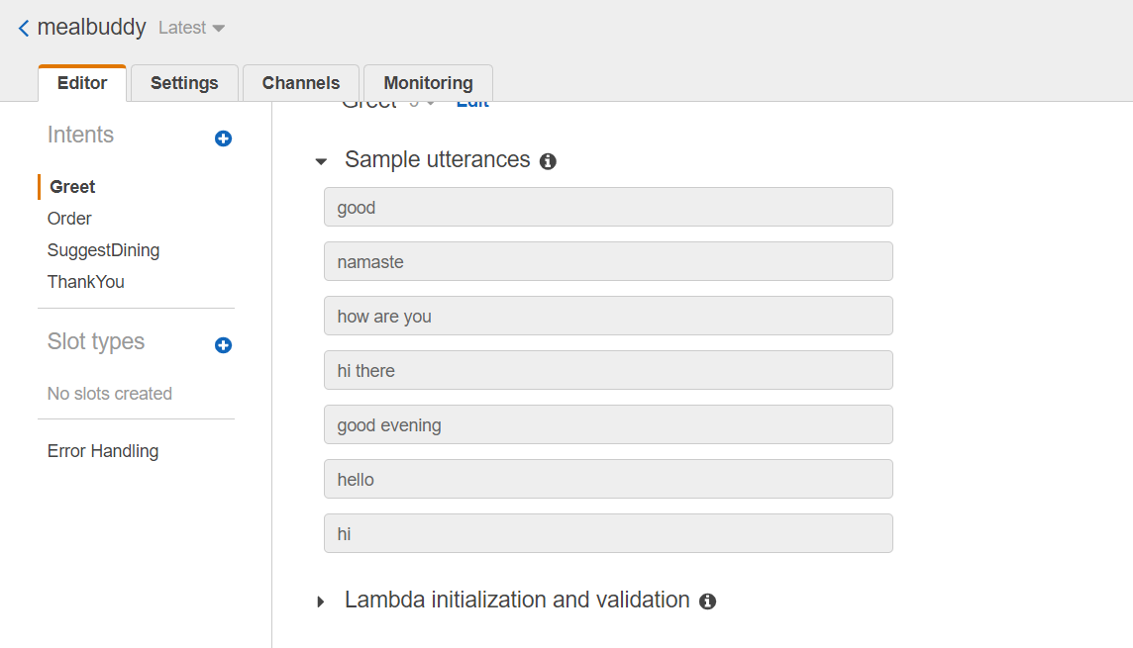
MealBuddy Chatbot using LEX
Lex is a conversational interface to applications using voice and text
3 steps:
Create new bot
Implement 3 intents(used for detecting the intention of the user)
GreetingIntent
ThankYouIntent
SuggestDiningIntent
Lambda function handles the responses of intents.

Slide 12
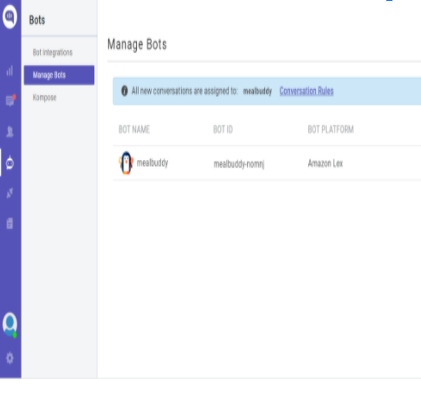
Integrate the Lex chatbot using Kommunicate
Kommunicate provides a code-less integration with Amazon Lex
Create a free Kommunicate account
Connect your Amazon Lex bot
Give your bot an identity
Enable/Disable human handoff
Assign all the incoming conversations to your Lex bot
Install the Kommunicate on your website

Slide 13
Create Lambda (LF1) using AWS Lambda service
AWS Lambda runs code called a Lambda function in response to an event
Lambda get invoked based on the three intents from Lex.
Dining Suggestions Intent collect information from the user, through conversation : Location, Cuisine, Dining Time, Number of people, Phone number
Added validation for the input json data (like phone number) in the python code.
Push the message to SQS (‘LF1SQSLF2.fifo’)

Slide 14
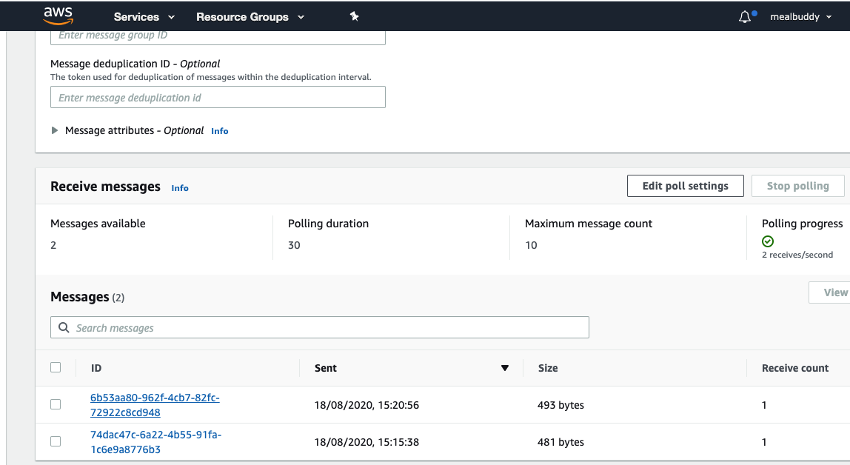
Push the information to an SQS queue
SQS Simple Queue Services
Used to decouple applications
Push the information collected from the user through mealbuddy chatbot to an SQS queue
Steps
Created fifo sqs ‘LF1SQSLF2.fifo’ to receive messages from lambda ‘LF1 '
Added dead letter sqs ‘deadSQS.fifo’ for isolated messages that cannot be processed correctly.
Message will be read by Lambda ‘LF2’

Slide 15
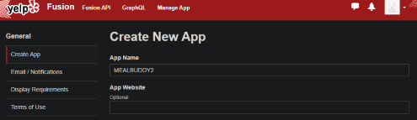
YELP FUSION API
Provides the best local contents and the user reviews , rating and all details like type of cuisine, location of the restaurants
API that allows developers to query the site's stored data and display Yelp reviews or ratings on their own sites.
Create account
Get the Client Id and API KEY

Slide 16
scrapeYelpData Lambda function
API_KEY = "######"
dynamodb = boto3.resource('dynamodb', region_name='us-east-1')
table = dynamodb.Table('yelp_restaurant')
API_HOST = 'https://api.yelp.com'
SEARCH_PATH = '/v3/businesses/search'
TOKEN_PATH = '/oauth2/token'
GRANT_TYPE = 'client_credentials'
Created scrapeYelpData Lambda function to insert yelp API- restaurant details to DynamoDB table

Slide 17
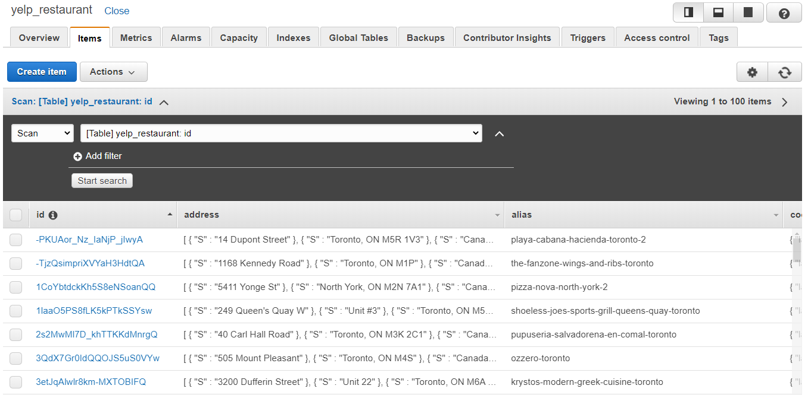
Insert into DynamoDB
Create a DynamoDB table and named “yelp-restaurant”
Get restaurants by your self-defined cuisine types
You can do this by adding cuisine type in the search term ( ex. Term: chinese restaurants)
Each cuisine type should have 1,000 restaurants or so.

Slide 18
Lambda function (LF2) acts as a queue worker
Handles majority of the processes
Read message from SQS
Delete the processed message using receipt handle
Search DynamoDB for restaurant details based on user input (Max 10)
Using Sagemaker Endpoint call make prediction and Top 3 results
Format the reply for user
Send the message using SNS
If any error send error message
Store the request and reply message in DynamoDB

Slide 19
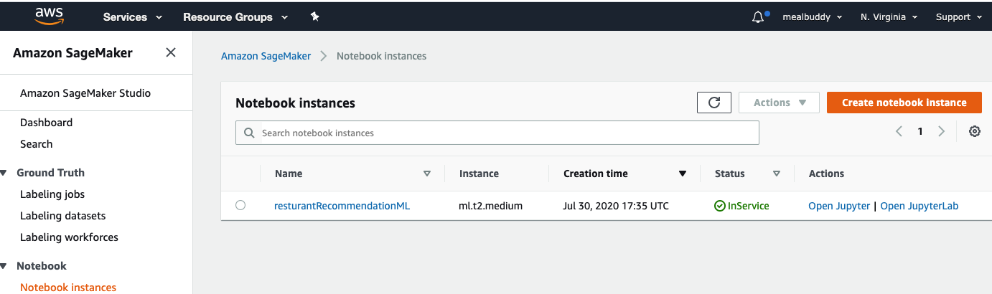
Create Sagemaker
Fully managed Machine Learning service.
Provides integrated Jupyter authoring notebook instances
Trained and tested random forest and xgboost ML algorithms
Deployed the XGBoost model to the sagemaker endpoint to be called from LF2.

Slide 20
Notification through SMS
Amazon Simple Notification Service (SNS) is a fully managed messaging service
It enables you to communicate between systems through publish/subscribe (pub/sub) patterns.
MealbuddySNS -----------> SMS -------> User
Triggered by AWS lambda LF2 using the Cloudwatch scheduled for 1 minute interval.

Slide 21
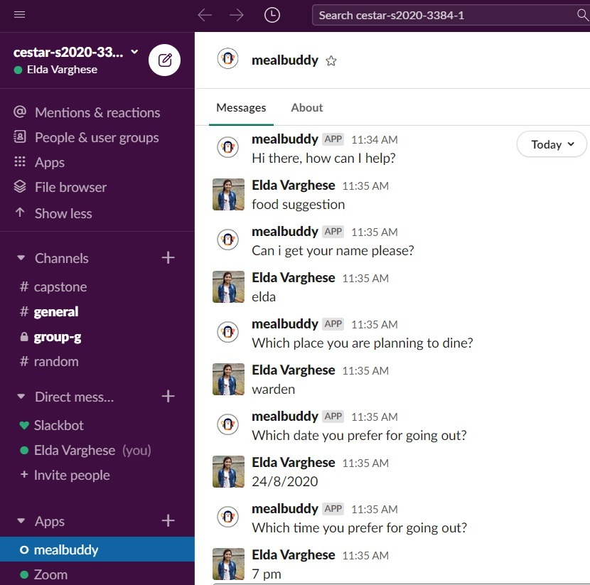
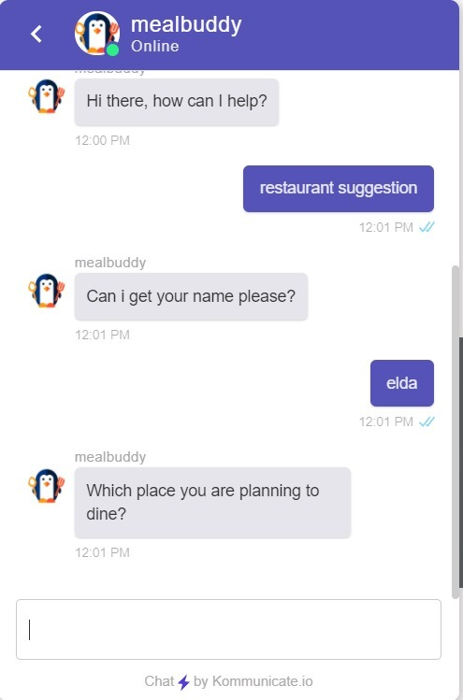
Chat Example

Slide 22
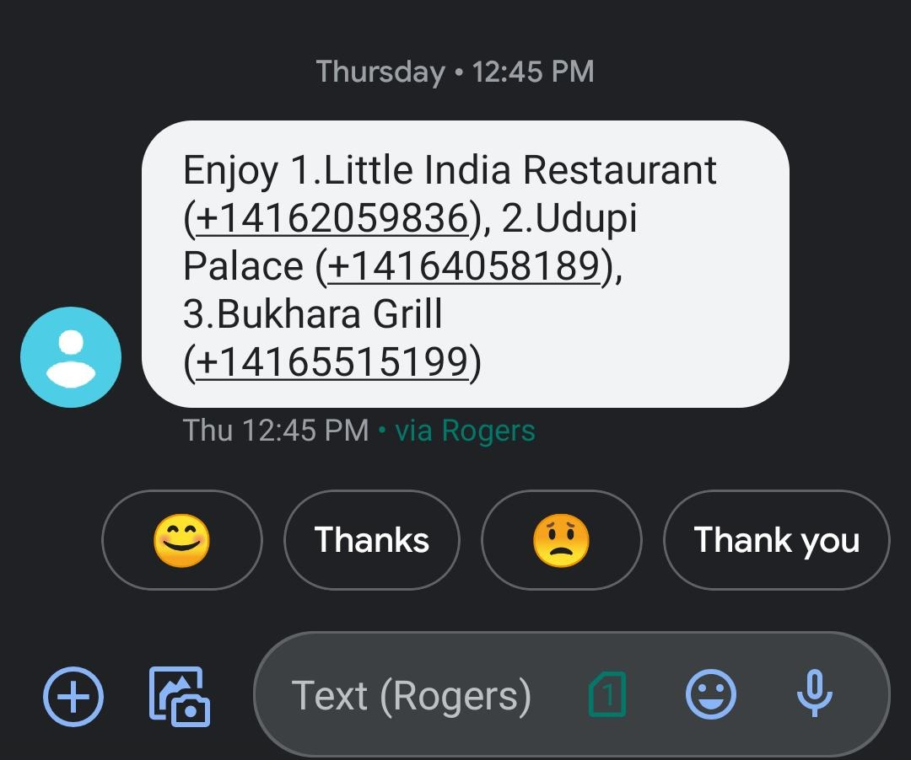
SMS Example

Slide 23
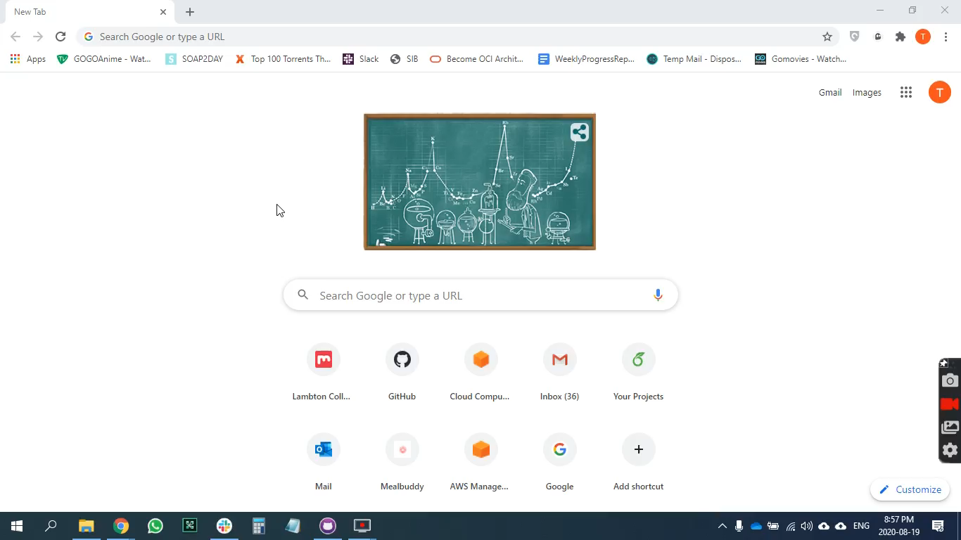
Demo

Slide 24
Results
The mealbuddy application was able to respond to user queries and give recommendations to users through sms.
The mealbuddy chatbot application built is a good example of serverless micro services based web application. AWS provides a good partner for creating such applications on cloud. The services provided by amazon are pretty good and deliver the services upto the expectations. We also explored the AWS big data and machine learning services such as AWS sagemaker.

Slide 25
Acknowledgement
We would like to express my very great appreciation to faculty supervisor Mr. William Pourmajidi for his valuable and constructive suggestions during the planning and development of this research work. His willingness to give his time so generously has been very much appreciated.

Slide 26
References
https://docs.aws.amazon.com/AmazonS3/latest/dev/WebsiteHosting.html
https://docs.aws.amazon.com/AmazonS3/latest/dev/HostingWebsiteOnS3Setup.html
https://docs.aws.amazon.com/lex/latest/dg/using-lambda.html
https://www.kommunicate.io/blog/amazon-lex-tutorial/
https://slack.com/intl/en-ca/help/articles/115004071768-What-is-Slack-
https://github.com/tom5167/mealbuddy

Slide 27
Questions?

